Slide 1
Transformations

Slide 2
Transformation
a change in size or location of an object.
Image
The ending figure after applying a transformation
Original
The starting figure before applying a transformation
Prime notation
- > Any point P is an original point.
-> P’ is the same point after the transformation is applied.

Slide 3
Reflection | Translation
Dilation | Rotation
“flip”
size stays the same
the orientation of the shape changes
(faces opposite direction)
“slide”
no change in size or shape
add and subtract to change points
“enlarge or reduce”
Size changes
Shape stays the same
Multiply and divide to change points
“turn”
Size and shape stay the same
orientation changes

Slide 4
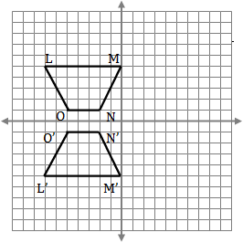
Reflections!
The reflection is the mirror image of the original figure → the line of reflection is the mirror.
If you were able to fold the picture along the line of reflection, the original figure and its reflection would align perfectly.

Slide 5
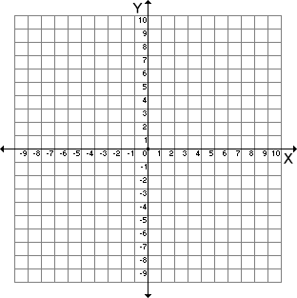
Example #1: Reflect the object below over the x-axis:
Name the coordinates of the original object:
A: (-5, 8)
A
B: (-6, 2)
D
C
C: (6, 5)
D: (-2, 4)
B
Name the coordinates of the reflected object:
A’: (-5, -8)
B’
B’: (-6, -2)
D’
C’: (6, -5)
C’
D’: (-2, -4)
A’
How were the coordinates affected when the object
was reflected over the x-axis?

Slide 6
Example #2: Reflect the object below over the y-axis:
Name the coordinates of the original object:
T’
T
T: (9, 8)
J: (9, 3)
Y: (1, 1)
J’
J
Name the coordinates of the reflected object:
Y’
Y
T’: (-9, 8)
J’: (-9, 3)
Y’: (-1, 1)
How were the coordinates affected when the object
was reflected over the y-axis?

Slide 7
Example #3: Reflect the object below over the x-axis and then the y-axis:
Name the coordinates of the original object:
R
Would it make a difference if we reflected over the y-axis first and then the x-axis? Try it! Then reflect about what you discovered.
R: (-9, 9)
P: (-8, 5)
P
D
D: (-2, 4)
U: (-9, 2)
U
Name the coordinates of the reflected object:
R’’: (9, -9)
U’
U’’
P’’: (8, -5)
D’
D’’
D’’: (2, -4)
P’
P’’
U’’: (9, -2)
R’
R’’
How were the coordinates affected when the object
was reflected over both the x-axis and y-axis?

